Slide 1

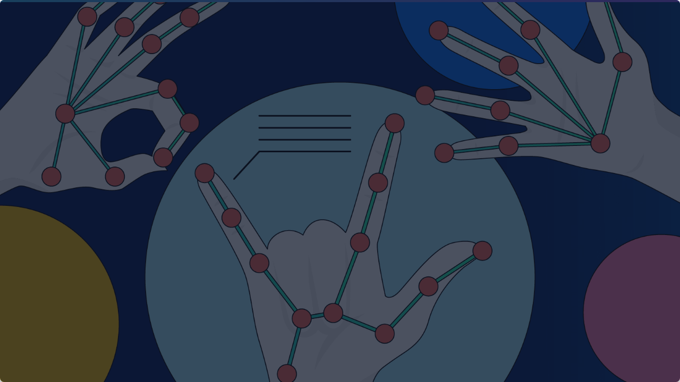
HAND GESTURE RECOGNITION SYSTEM (ASL)
HAND GESTURE RECOGNITION SYSTEM (ASL)
Bridging Communication with AI & Computer Vision
Bridging Communication with AI & Computer Vision
Mahmoud Elsherbiny | Samy Ali | Mazen Ibrahim | Ahmed Ali
Mahmoud Elsherbiny | Samy Ali | Mazen Ibrahim | Ahmed Ali
Kerols Ibrahim | Yousef Ahmed | Fouad Hassan
Kirollos safwat | Yousef Ahmed | Fouad Hassan

Slide 2

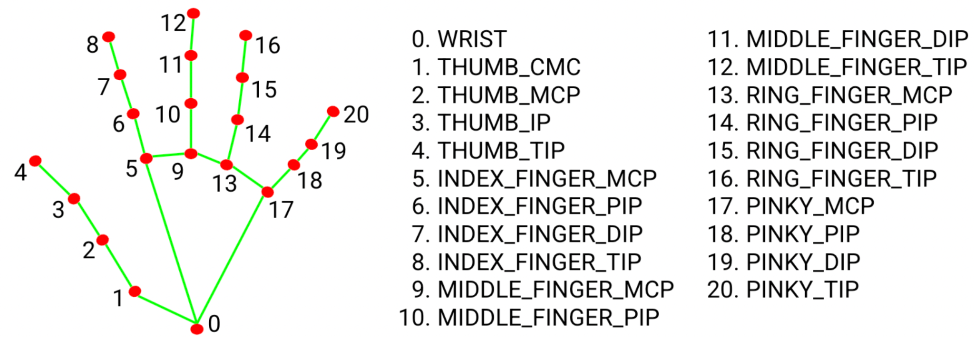
PROJECT OVERVIEW
PROJECT GOAL
Develop an intelligent system to recognize American Sign Language (ASL) gestures using computer vision to facilitate communication for deaf individuals.
CORE TECHNOLOGY
Leverages MediaPipe to extract 21 3D hand landmarks from a live webcam feed. These landmarks feed into a trained MLP Neural Network for real-time alphabet classification.

Slide 3

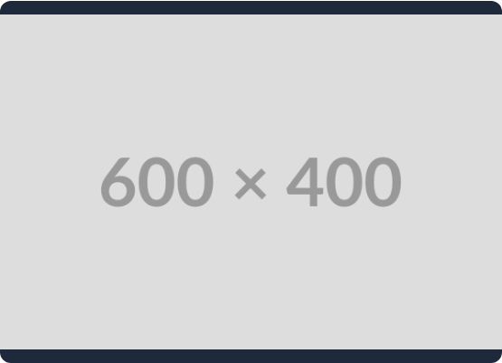
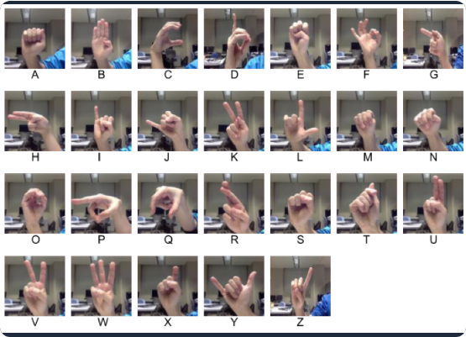
DATA COLLECTION & OVERVIEW
Source: Kaggle ASL Alphabet Dataset.
Volume: 63,673 Total Samples Used.
Classes: 28 total (A-Z, "del", "space").
Feature Strategy: Instead of raw pixels, we extracted 21 landmarks × 3 coordinates (x,y,z) = 63 features per image.
Split: 85% Training / 15% Validation.

Slide 4






DATA PREPROCESSING PIPELINE
FEATURE EXTRACTION
VECTORIZATION
ENCODING & SPLIT
MediaPipe detects 21 hand landmarks. We extract (x, y, z) coordinates for a lightweight representation.
Coordinates are flattened into a single, normalized 63-feature vector, significantly lighter than raw images.
Labels are one-hot encoded. Data is split using stratified sampling to maintain class balance.

Slide 5
KEY OBJECTIVES
Landmark Detection: Detect and extract 21 3D hand landmarks in real-time using MediaPipe Hands.
Network Design: Build a fully connected neural network (MLP) using TensorFlow/Keras.
Classification: Train the model to accurately classify 28 ASL classes (A-Z, space, del).
Evaluation: Utilize visualization metrics to ensure high performance and generalization.
Deployment: Deploy the trained model into a responsive, real-time webcam system.

Slide 6

PROJECT PIPELINE: SYSTEM FLOW
SYSTEM WORKFLOW
PREPROCESSING
SMOOTHING
MediaPipe Extraction
Temporal Filtering
ACQUISITION
INFERENCE
Webcam / Dataset
MLP Prediction

Slide 7

MLP MODEL ARCHITECTURE
LAYER STRUCTURE
OPTIMIZATION
Input: 63 neurons (Feature Vector)
Optimizer: Adam
Hidden 1: 256 neurons (ReLU)
Loss Function: Categorical Crossentropy
Hidden 2: 128 neurons (ReLU)
Regularization: Batch Normalization & Dropout layers implemented to prevent overfitting and ensure stability.
Hidden 3: 64 neurons (ReLU)
Output: 28 neurons (Softmax)

Slide 8
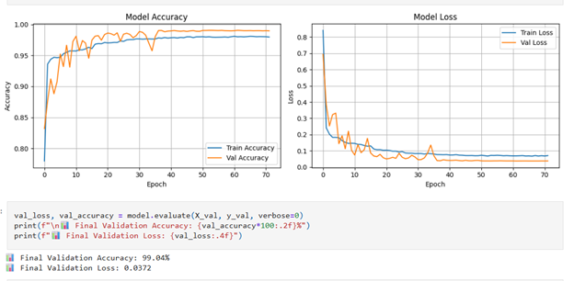
TRAINING PROCESS & CALLBACKS
Epochs: Set for 100, halted at 72 by Early Stopping.
EarlyStopping: Monitors validation loss to prevent overfitting.
ModelCheckpoint: Saves the best weights based on validation accuracy.
ReduceLROnPlateau: Lowers learning rate when performance plateaus.
RESULT
Smooth convergence with minimal overfitting, achieving 99.04% validation accuracy.

Slide 9


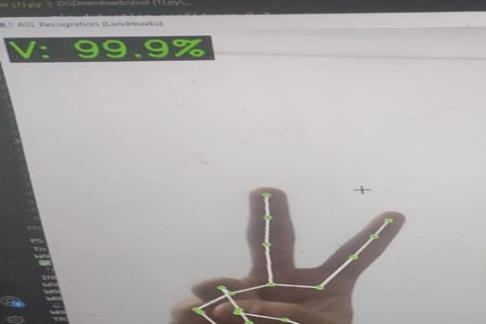

FINAL PERFORMANCE METRICS
99.04%
0.037
25 FPS
Validation Accuracy
Validation Loss
Inference Speed

Slide 10

CHALLENGES & SOLUTIONS
OVERFITTING
FRAME INSTABILITY
Model began memorizing training data (high train acc, plateauing val acc).
Real-time predictions flickered rapidly due to minor hand wobbles.
Solution: Implemented Dropout, Batch Normalization, and Early Stopping to ensure generalization.
Solution: Temporal Smoothing. Stored last 5 predictions and displayed only the most frequent label (mode). This stabilized output dramatically.

Slide 11
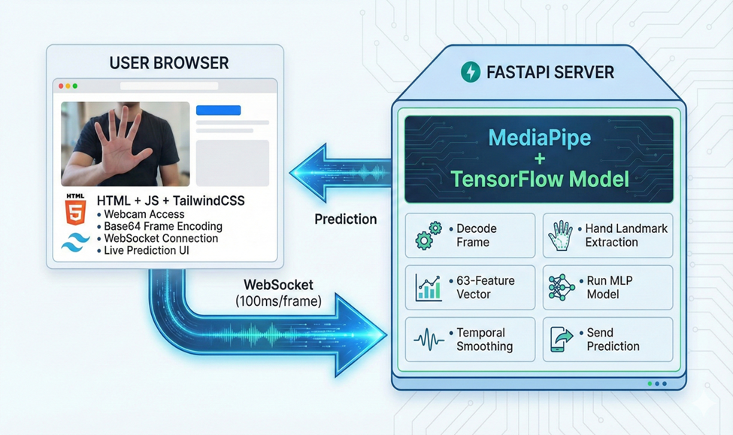

DEPLOYMENT ARCHITECTURE: REAL-TIME COMMUNICATION
Frames are sent from the Custom Browser Frontend (HTML/JS) via WebSockets (100ms/frame) to the FastAPI Server for inference, ensuring low-latency communication.

Slide 12
FUTURE DEVELOPMENT & MARKETING
Dynamic Gestures: Expand dataset and model to include moving gestures (full words/phrases).
Edge Deployment: Model is lightweight (61k parameters), ideal for mobile/IoT devices.
Marketing: Target applications for accessible communication and language learning.
Bidirectional System: Integrate Text-to-Speech (TTS) for a full conversational tool.

Slide 13
TOOLS & LIBRARIES
Python: Core logic.
TensorFlow/Keras: MLP Model.
MediaPipe: Landmark Detection.
OpenCV: Image Processing.
FastAPI: Backend WebSocket Server.
NumPy/Pandas: Data Manipulation.

Slide 14
Questions?
thanks you for your attention

